Slide 1
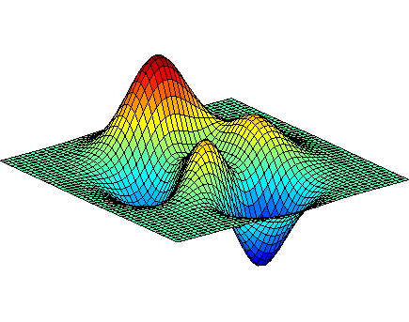
Introduction in MATLAB Image Processing Toolbox
By Shahriar Yazdipour

Slide 2
Agenda
Applications of Image Processing
Image Pre processing
Image segmentation
Colors
IP Toolbox Functions
Edge Detection
Blur
Demo
Display and working with tools
Colors
Blurring
Edge detection
Segmentation
Road line detection
Sudoku Solver

Slide 3
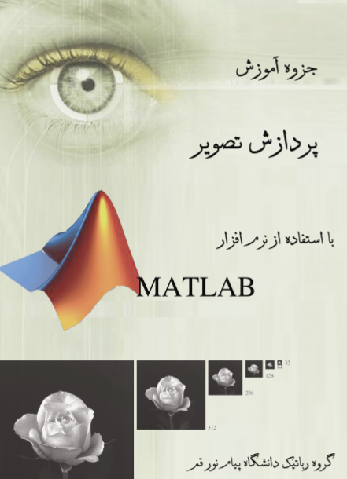

Resources and demo files
Demos + PPT + eBook
http://www.slideshare.net/ShahriarYazdipour/
https://github.com/yazdipour/Intro-Matlab-Image-Processing
http://shahriar.in/blog/post/141
Documents
http://mathworks.com/matlab
http://mathworks.com/matlabcentral
https://www.mathworks.com/products/image.html

Slide 4
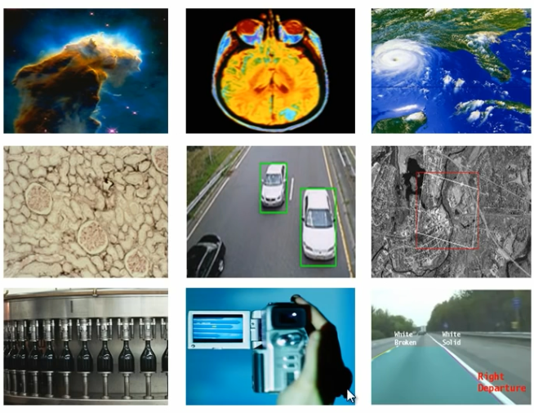
Applications of Image Processing
Robotics
Medical imaging
Automotive safety
Geospatial computing
Surveillance
And more …
Notes:
برای هرکدوم مثال
موقعیت شناسی – نقشه – در جنگ
نظارت و نگهبانی – حالاچه امنتی چه کارخونه

Slide 5
Pre Processing
Image enhancement is the process of adjusting digital images so that the results are more suitable for display or further processing.
Such as:
Reduce noise
Deblurring
Brightness Adjusting
Color Adjusting
…

Slide 6
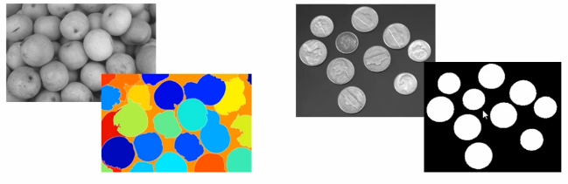
Image segmentation
Image segmentation is the process of dividing an image into multiple parts. That is typically used to identify objects and other relevant information within an image.

Slide 7
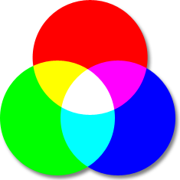
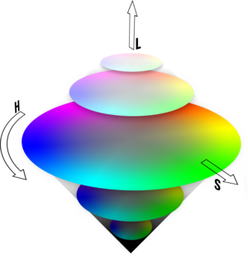
Colors
http://www.colorizer.org/
RGB (A)
Red, which ranges from 0-255
Green, which ranges from 0-255
Blue, which ranges from 0-255
Alpha Channel for transparency
HSL
Hue : the color type (such as red, blue,..) Ranges from 0 to 360° in most applications (each value corresponds to one color : 0 is red, 45 is a shade of orange and 55 is a shade of yellow).
Saturation : variation of the color depending on the lightness.
Ranges from 0 to 100% (center = lightest).
Lightness (also Luminance or Luminosity or Intensity).
Ranges from 0 to 100% (from black to white).
Notes:
Power Details : HSL > RGB
Compression : HSL > RGBA
Process : HSL > RGBA

Slide 8
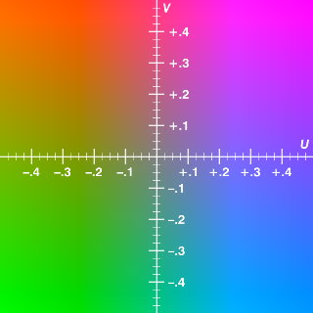
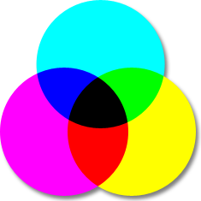
Colors
YUV
Y, the luma component, or the brightness.
Ranges from 0 to 100% in most applications.
U and V are the chrominance components
CMYK
Cyan.
Ranges from 0 to 100% in most applications.
Magenta.
Yellow.
blacK
Notes:
YUV = for Camera – u can find Android Algorithm in WIKI
CMYK = usage in Printing on Paper

Slide 9
IP Toolbox Functions
Imread(fileDir,[fileType])
Imwrite(Matrix,fileDirToSave,[fileType])
Imshow(M)
Imtool(M)

Slide 10
IP Toolbox Functions
Imcrop(I,[x,y,width,height]) %%submatrix
Rgb2gray(I)
Im2bw(I,level)
Bwlabel(bw)
Imfeature(I,’all’) OR regionprops(I,’all’)
Area / Centeroid / BoundingBox / Eccentricity
Orientation / PixelList /...

Slide 11
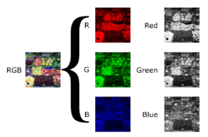
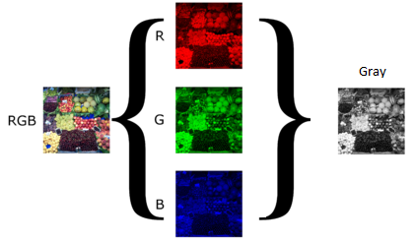
RGB to Gray
Gray = Red = I[:,:,1] Gray = Green = I[:,:,2] Gray = Blue = I[:,:,3]
Gray = (Red + Green + Blue) / 3

Slide 12


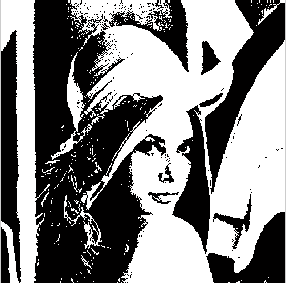
RGB to Black & White
Bw= im2bw(Image,level)
Image must be a 2D Matrix.
Default Level: 0.5

Slide 13
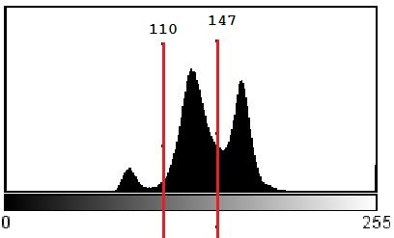
Computing Level
if (level*255 > PixelVal) PixelVal=1;
else PixelVal=0;
To compute the level argument,
we can use the function graythresh
The graythresh function uses Otsu's method, which chooses the threshold to minimize the intraclass variance of the black and white pixels.
Otsu, N., "A Threshold Selection Method from Gray-Level Histograms," IEEE Transactions on Systems, Man, and Cybernetics, Vol. 9, No. 1, 1979, pp. 62-66.

Slide 14
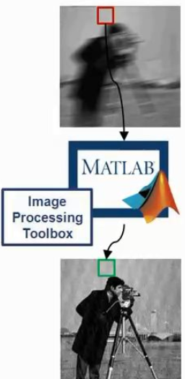
IP Toolbox Functions
B = blockproc(A,[M N],func)
Execute func foreach [M N] size matrix inside A.
Use it to:
Manage speed and memory
Sometimes more accurate

Slide 15
IP Toolbox Functions
IPPL: Intel Integrated Performance Primitives Library
Imadd
Imdivide
Immultiply
Imabsdiff
Imcomplement
…

Slide 16
IP Toolbox Functions
Imnoise
imnoise(I,'salt & pepper',d) adds salt and pepper noise to the image I, where d is the noise density. This affects approximately d*numel(I) pixels. The default for d is 0.05. (On off method)
imnoise(I,'speckle',v) adds multiplicative noise to the image I, using the equation J = I+n*I, where n is uniformly distributed random noise with mean 0 and variance v. The default for v is 0.04.
medfilt2(A,m,n) :2-D median filtering
median filtering is a nonlinear operation often used in image processing to reduce "salt and pepper" noise. A median filter is more effective when the goal is to simultaneously reduce noise and preserve edges
Each output pixel contains the median value in the m-by-n neighborhood around the corresponding pixel in the input image. medfilt2 pads the image with 0s (Black) on the edges.

Slide 17
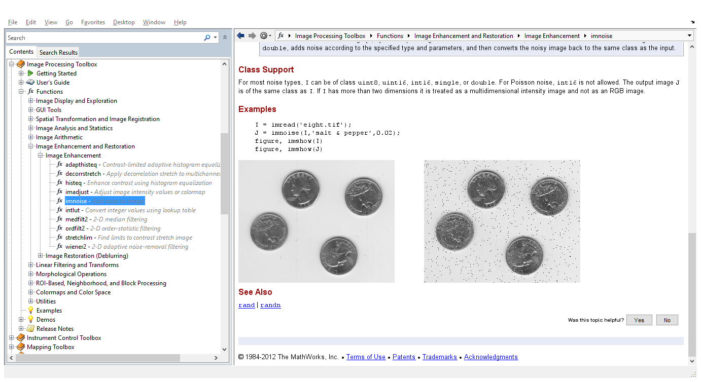
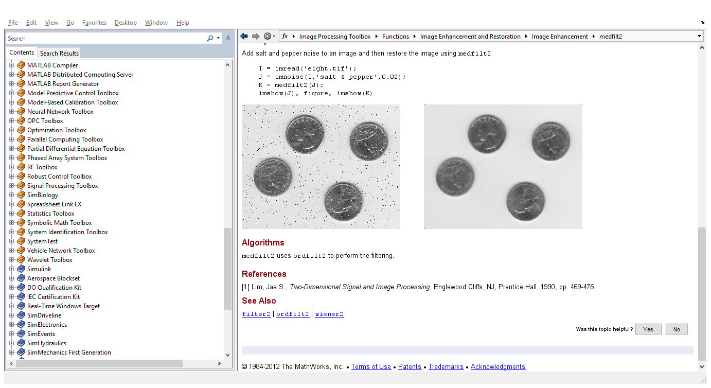
Salt & Pepper noise + medfild2

Slide 18
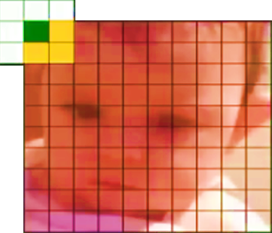
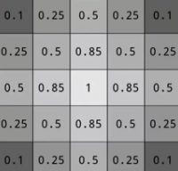
Blurring
Gaussian blur
PSF = fspecial('gaussian',3);
B=imfilter(I,PSF,'symmetric');
Gaussian blur
With weighed kernel
Notes:
'symmetric = متقارن

Slide 19
IP Toolbox Functions
BW = edge(I,[thresh]) takes a grayscale or a binary image, and returns a binary image
The Prewitt method finds edges using the Prewitt approximation to the derivative. It returns edges at those points where the gradient of Image is maximum.
Roberts
Sobel
The Canny
Canny, John, "A Computational Approach to Edge Detection," IEEE Transactions on Pattern Analysis and Machine Intelligence,Vol. PAMI-8, No. 6, 1986, pp. 679-698.
Lim, Jae S., Two-Dimensional Signal and Image Processing, Englewood Cliffs, NJ, Prentice Hall, 1990, pp. 478-488.
Parker, James R., Algorithms for Image Processing and Computer Vision, New York, John Wiley & Sons, Inc., 1997, pp. 23-29.
Notes:
Approximation = تقریب – نزدیک
Derivative = مشتق

Slide 20
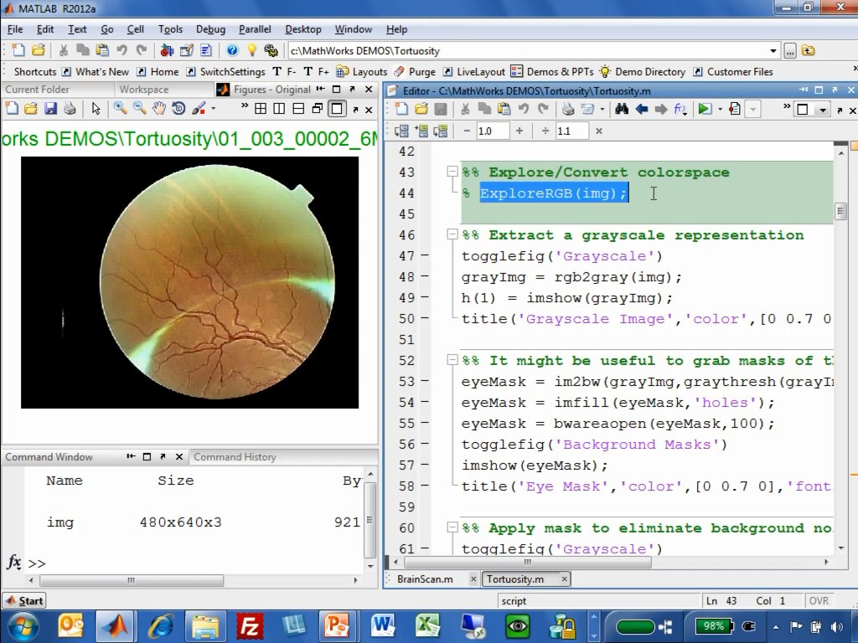
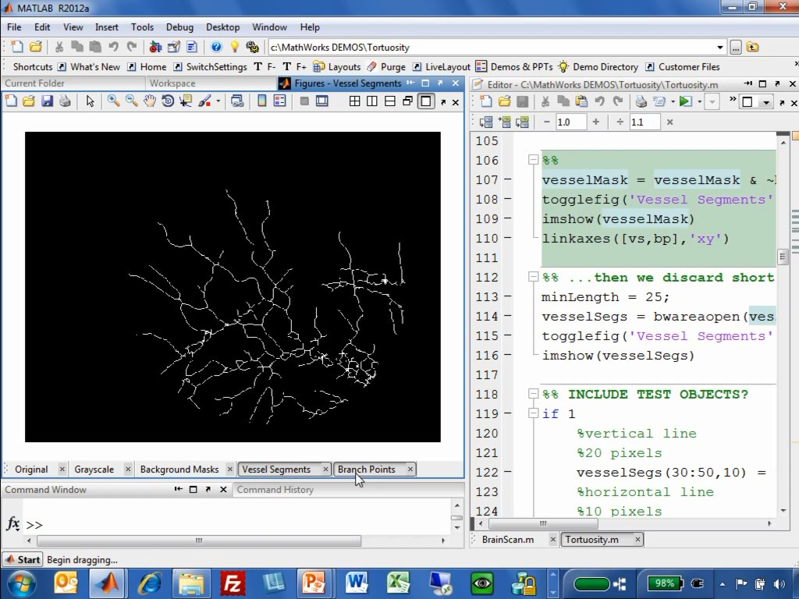
Edge Detection

Slide 21
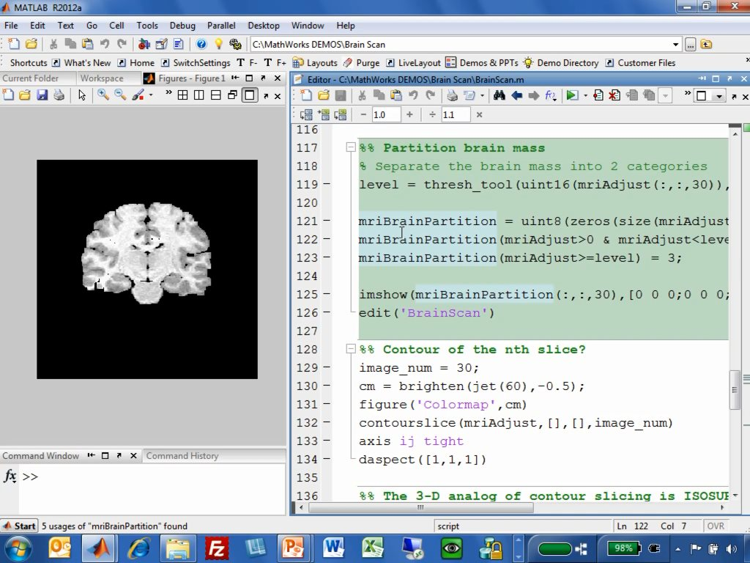
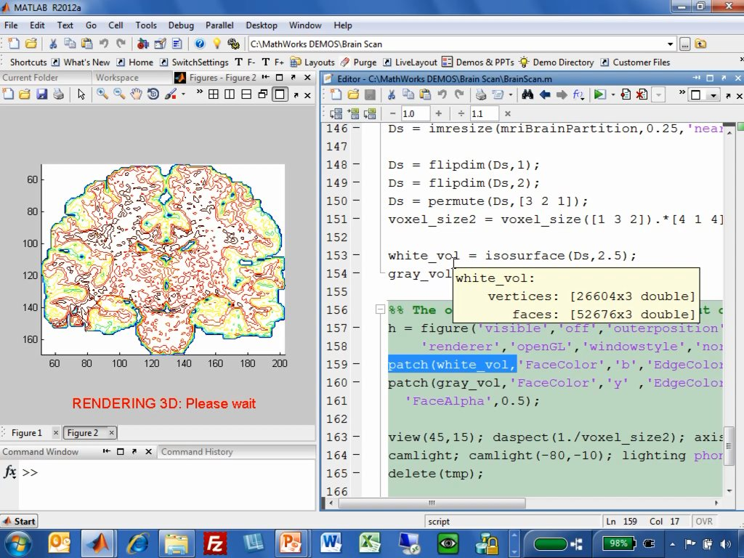
Edge Detection

Slide 22
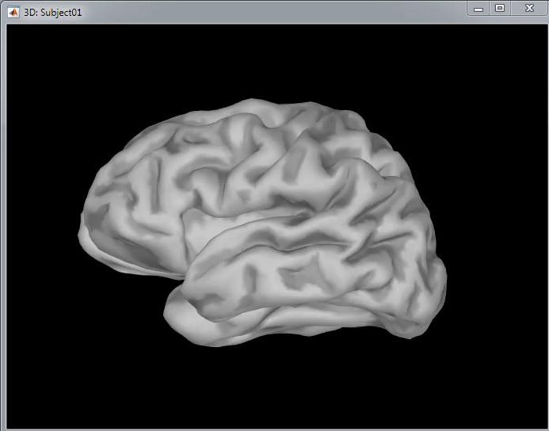
Edge Detection

Slide 23
DEMO TIME
Tools
Edge Detections
blurring
Segmentation
Road
Sudoku

